Slide 1

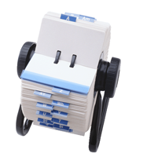

Databases

Slide 2

Databases
What do you think the word ‘database’ means?
DEFINITION:
A database is a collection of data or information which is stored in a logical and structured way

Slide 3

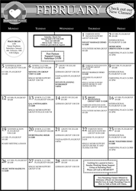


Paper-based databases

Slide 4
Paper-based databases
Think of some advantages for paper-based databases
Cheap to set up
Don’t need electricity, so will work if you have a power-cut
Don’t need a computer – which is expensive
Can carry them around with you
Don’t need training to learn how to use them

Slide 5
Paper-based databases
Think of some disadvantages for paper-based databases
Can be lost
Can’t easily make back-up copies
Hard to update or make changes
Card systems can get in a muddle if cards not replaced in the correct order
Can take a while to search for a particular record

Slide 6
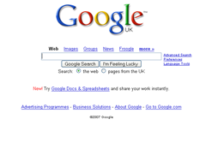
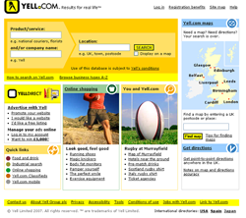
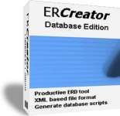

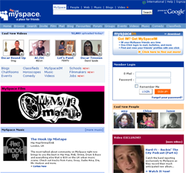

Computer-based databases

Slide 7
Computerised databases
Think of some advantages for computerised databases
Can easily make back-up copies
Can easily make changes
Can easily sort data into order e.g. alphabetic
Can search for particular records very quickly
Can import or export data to/from other packages

Slide 8

Computerised databases
Think of some disadvantages for computerised databases
Can be expensive to set up if you have to get a professional to make it
If there is a power-cut, you can’t use it
You need to have a computer
Cannot carry it around with you – unless you take a computer
You often need training to learn how to use them

Slide 9
Database Terms
Your school keeps a lot of information about every student.
Think of some of the information they keep about you.

Slide 10
Database Terms
Your school keeps a lot of information about every student.
Think of some of the information they keep about you.
allergies
parent’s names
name
address
illnesses
doctor’s name
phone number
d.o.b.

Slide 11
Field
Each of these is one piece of information about you.
name
address
d.o.b.
doctor’s name
Each of these different types of information is called a ‘Field’
parent’s names
phone number
illnesses
allergies

Slide 12
Field
field
field
field
Student number | Surname | First name | D.O.B. | Address | Phone number | Illnesses | Allergies | Doctor
1042 | Jones | Emma | 05/04/95 | 123 High Street | 01234 765555 |  | Nuts | Dr. Brown
1043 | Smith | Louise | 12/08/95 | 45 Low Road | 01234 688674 | Diabetes |  | Dr. Green
1044 | White | Simon | 26/06/95 | 67 Middle Lane | 01234 984532 |  | Wasp stings | Dr. Yellow

Slide 13

Field
A shop selling DVDs has a database.
What would be the field names in their database?
Running time
title of DVD
genre
price
how many in stock
actors

Slide 14
Record
All of the ‘fields’ are put together to make a ‘record’
A ‘record’ is all of the data about one person or one thing.

Slide 15
Record
record
Student number | Surname | First name | D.O.B. | Address | Phone number | Illnesses | Allergies | Doctor
1042 | Jones | Emma | 05/04/95 | 123 High Street | 01234 765555 |  | Nuts | Dr. Brown
1043 | Smith | Louise | 12/08/95 | 45 Low Road | 01234 688674 | Diabetes |  | Dr. Green
1044 | White | Simon | 26/06/95 | 67 Middle Lane | 01234 984532 |  | Wasp stings | Dr. Yellow
record

Slide 16
Record
field
Student number | Surname | First name | D.O.B. | Address | Phone number | Illnesses | Allergies | Doctor
1042 | Jones | Emma | 05/04/95 | 123 High Street | 01234 765555 |  | Nuts | Dr. Brown
1043 | Smith | Louise | 12/08/95 | 45 Low Road | 01234 688674 | Diabetes |  | Dr. Green
1044 | White | Simon | 26/06/95 | 67 Middle Lane | 01234 984532 |  | Wasp stings | Dr. Yellow
record

Slide 17
File
All of the ‘records’ are stored together as a ‘file’
file
Student number | Surname | First name | D.O.B. | Address | Phone number | Illnesses | Allergies | Doctor
1042 | Jones | Emma | 05/04/95 | 123 High Street | 01234 765555 |  | Nuts | Dr. Brown
1043 | Smith | Louise | 12/08/95 | 45 Low Road | 01234 688674 | Diabetes |  | Dr. Green
1044 | White | Simon | 26/06/95 | 67 Middle Lane | 01234 984532 |  | Wasp stings | Dr. Yellow
1045 | Wood | James | 14/05/95 | 89 Uphill Drive | 01234 927347 |  |  | Dr. Black
1046 | Wythe | Hannah | 18/04/95 | 101 Down Avenue | 01234 836475 | Asthma | Plasters | Dr. Blue

Slide 18
Database Terms
A ‘database’ is a collection of data or information which is stored in a logical and structured way
A ‘field’ is one type or piece of information
A ‘record’ is all of the information about one person or one thing
A ‘file’ is the collection of all the database records on one topic or subject

